Slide 1
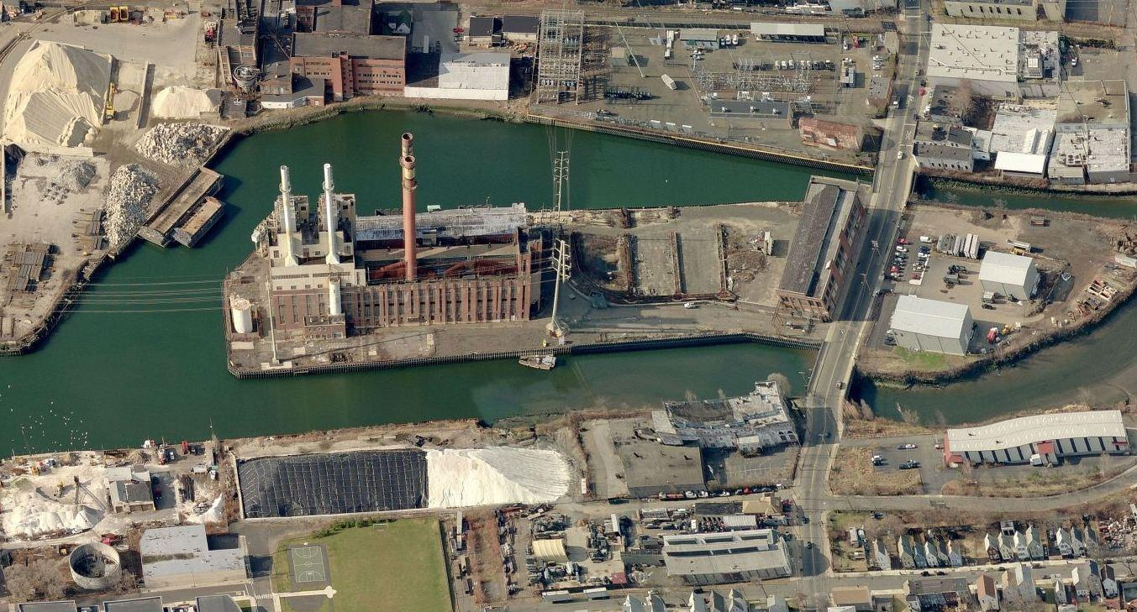
English Station Update Meeting
March 11, 2019

Slide 2
Agenda
Background and History
Project Milestones
Completed
Current
Planned
Site Safety Precautions
Building Abatement
Site Remediation
Next Steps
Keeping You Informed

Slide 3
Background
Station B
(Parcel A)
English Station
(Parcel B)
North
Grand Ave

Slide 4
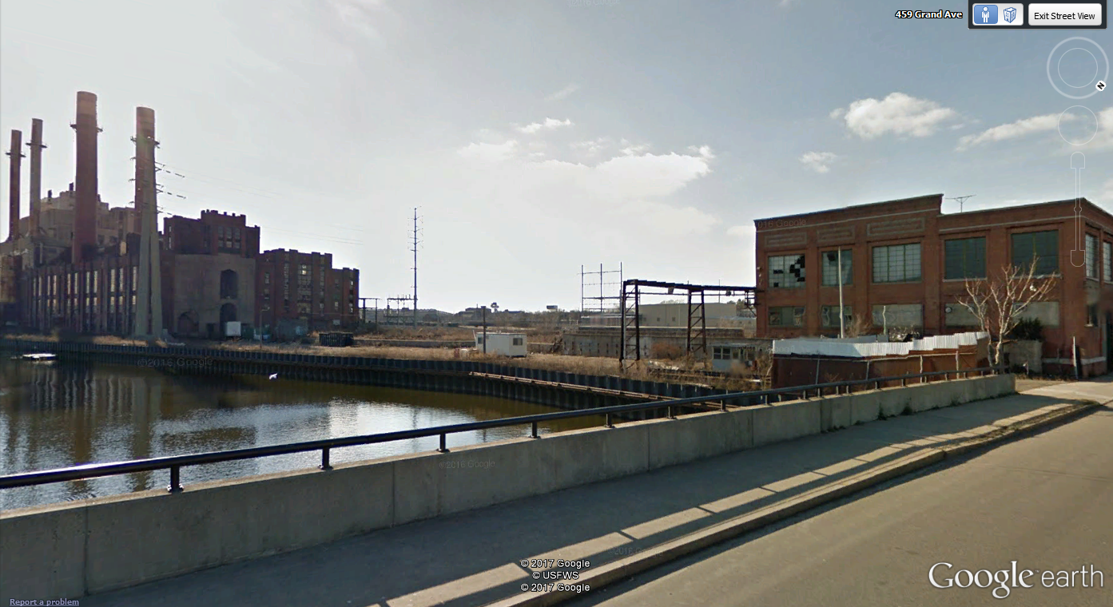
Background
English Station
Station B
Grand Ave

Slide 5
Background The English Station Site is approximately 8.9 acres The Station B building on Parcel A fronting on Grand Ave has a footprint of approximately 25,000 square feet The English Station building on Parcel B has a footprint of approximately 100,000 square feet History 1890 – Station B provides electricity to Greater New Haven 1929 – English Station begins operation as a coal-fired electric generating station 1958 – English Station is converted to oil-fired generation 1992 – English Station moves power plant to deactivation status 2000 – UI sells English Station property to an unaffiliated party 2006 – Property subdivided by then owner, 5.3 acre English Station Parcel sold to ASNAT Realty and 3.6 acre Station B parcel sold to Evergreen Power 2015 – UI agrees to investigate and remediate the on-site conditions under the Partial Consent Order 2016 – UI begins on-site investigation 2018 – Property sold to Haven River Properties (Parcel A) and Paramount View Millennium LLC (Parcel B)
Background and History of the Site

Slide 6
Remediation Requirements
Remediation Requirements are described in Partial Consent Order (PCO) COWSPCB 15-001 issued by CT-DEEP, and consented to by UI.
Soil and Groundwater
Buildings
Standards are established by State and Federal Law and Regulations.

Slide 7
Completed Work: Project Statistics
On-site investigation began in August 2016
UI has contracted with TRC – Licensed Environmental Professional & Engineering Services
To date, UI, TRC and other contractors have performed multiple activities, including:
Removed over 50,000 bags of asbestos waste
~10,000 soil samples over the course of all investigations
~1,400 concrete samples
~4,300 building material samples
Sampled 33 groundwater wells five times over a 14-month period
Since the PCO:
Submitted three separate investigative reports for CT DEEP review
Submitted four separate remedial action plans
Performed interim abatement activities within Main Power Plant - over 70 personnel on-site to perform abatement
Performed Station B (original power plant) concrete remediation
All work has been performed with 0 safety incidents

Slide 8
Current Activities
Obtaining multiple City of New Haven, CT DEEP, CT DPH and US EPA permits or authorizations for remedial activities
Installed barriers along Grand Ave to protect the public from falling bricks and other debris because of the ongoing deterioration of Station B on Parcel A
Continuing to assess and sample Main Power Plant
To date, under the PCO, the following have been collected:
-~2,000 building material samples
-~100 sediment samples from inside English Station
-~200 soil samples
-~50 standing water samples inside English Station

Slide 9
Next Steps
Based on the results of our environmental investigation and the poor condition of Station B, coupled with a demolition order from the City of New Haven to demolish the original power plant, Station B is expected to be demolished
Remediate PCB impacted soil and concrete materials on Parcels A & B
Perform remediation of other contaminants as defined in the remedial action plans
Perform confirmation soil sampling
Install four feet of clean fill or two feet of clean fill with pavement in select area(s)

Slide 10
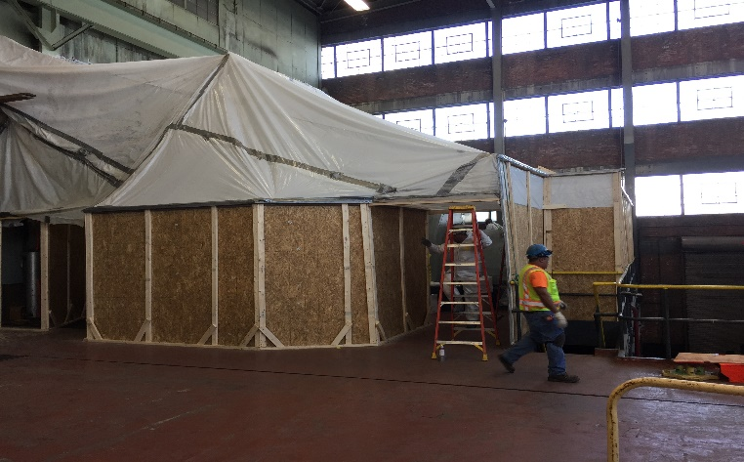
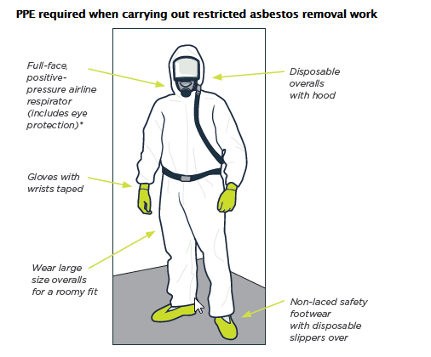
Building Abatement Environmental Safety Precautions (Past and Future)
Sealed poly containments established to completely enclose work area
HEPA filtered negative air used in containments to prevent airborne releases
Negative air pressure monitored continuously
Air sampled outside containments
All wastes placed in sealed double bags/boxes before leaving containment and placed in secure trailers
All materials and personnel leaving containment decontaminated
Wash water collected and contained at lower elevations inside containment areas
Licensed asbestos monitors provide ongoing evaluation of work areas as well as means and methods to ensure against contaminant release
Typical Containment

Slide 11
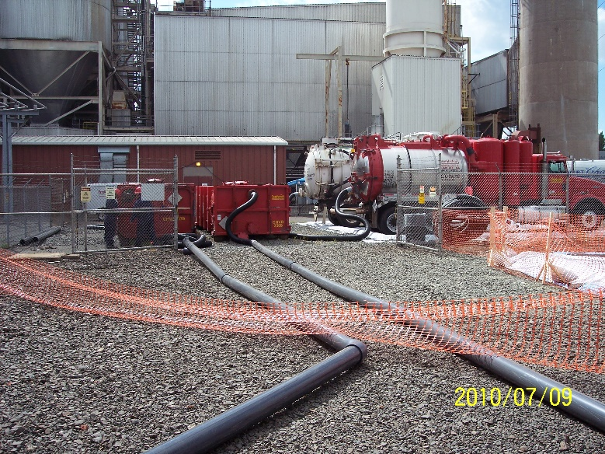
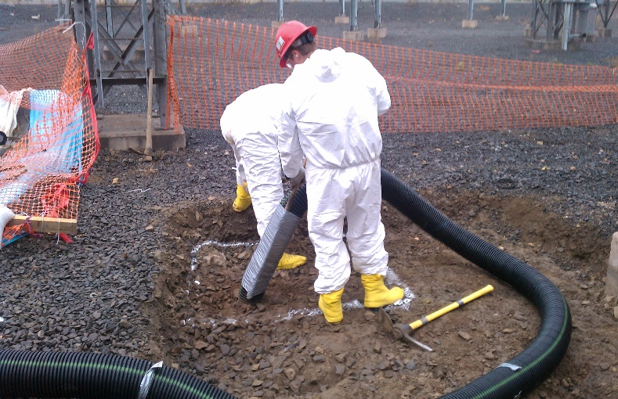
Onsite Remediation Environmental Safety Precautions
Enclose site perimeter with silt fence and staked hay bales
Construct decontamination area for all vehicles leaving site
Containerize all decontamination wash water & liquids
Liberal site-wide use of water sprays/mist for dust control
All wastes placed in covered/sealed roll-off containers inside a lined and secure fenced area
Materials and personnel decontaminated before leaving site
Ambient air monitoring
Trained remedial inspectors
Provide ongoing evaluation of work areas as well as means and methods to ensure against contaminant release
Typical Waste Storage Area
PCB Remediation

Slide 12
Community Safety –
UI will continue to use its traffic control measures such as jersey barriers and fencing to limit access to the sidewalk along Grand Ave and maintain one lane of traffic to protect the public from loose debris falling from Station B
On-site program to monitor the potential dust emissions during soil remediation activities
Erosion and sediment control measures
Prevent soil migration off-site during remediation activities

Slide 13
Keeping you informed
The English Station Remediation Project website will continue to be updated regularly as new information becomes available.
An informational web page is available at www.uinet.com/englishstation
For additional inquiries, please call UI’s Public Outreach Office
(203) 499-3824

Slide 14
Questions

